Slide 1

Economic recovery undermined by broader uncertainty
Quarry NZ Conference 2025
.
Brad Olsen (Chief Executive and Principal Economist)
10 July 2025

Slide 2
Project analysis slide 2
An unstable world

Slide 3
Project analysis slide 2
Export markets

Slide 4
Where is NZ’s recovery at?

Slide 5
Project analysis slide 2
Consumer confidence and spending

Slide 6
Project analysis slide 2
Activity

Slide 7
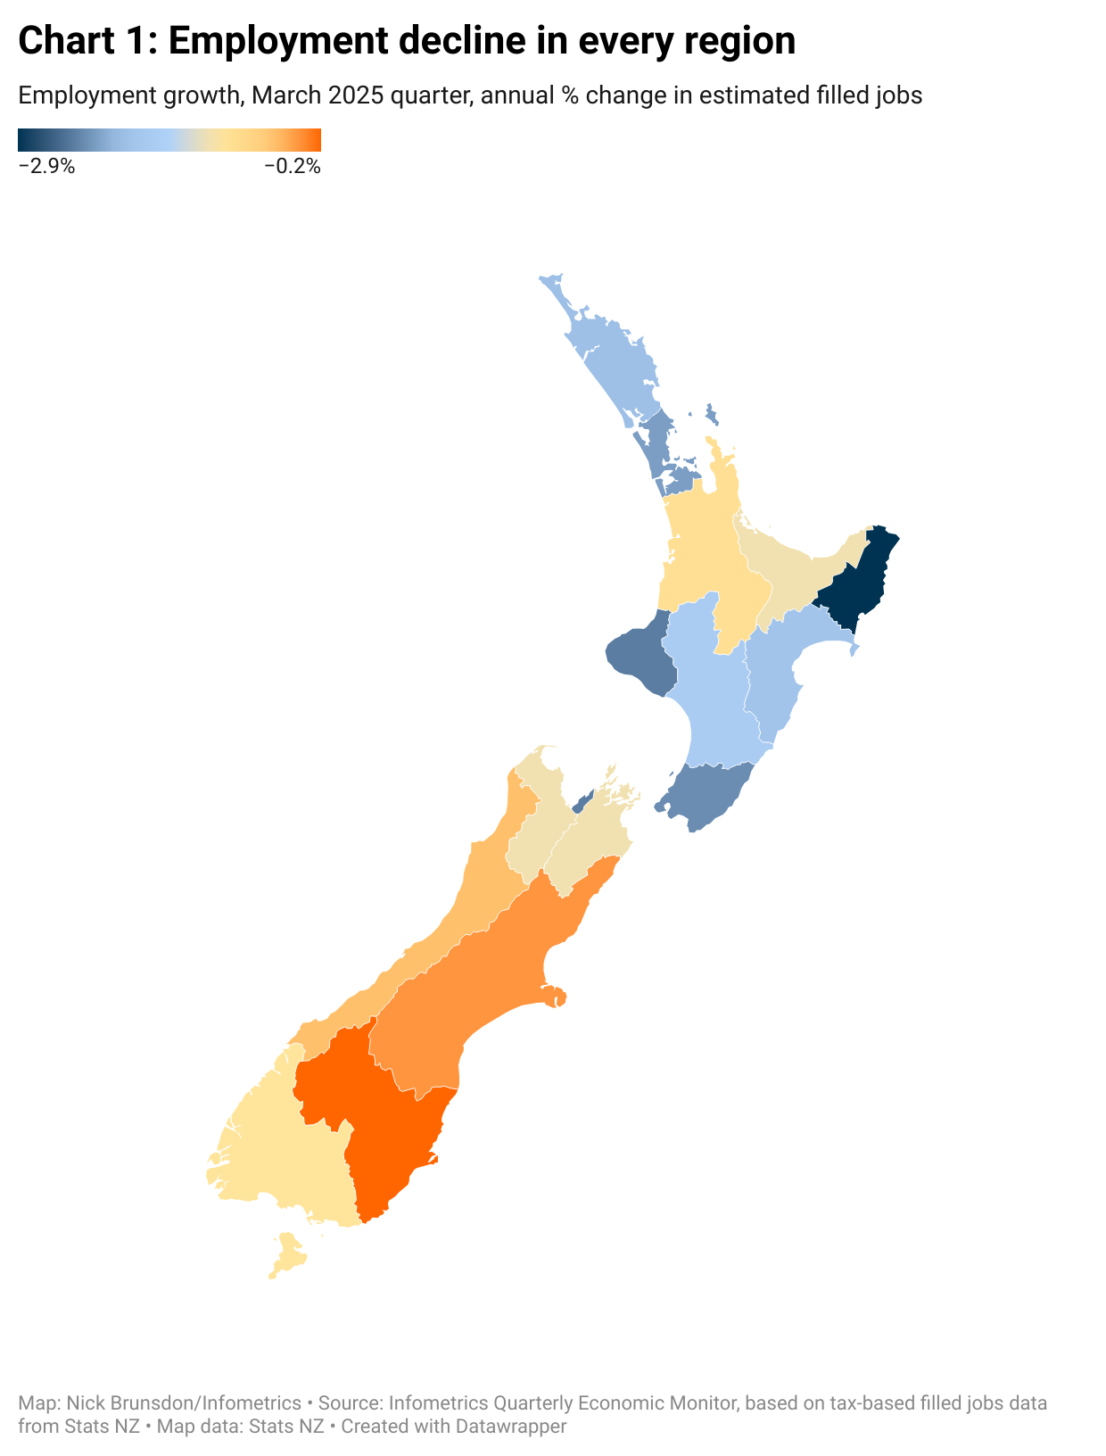
Project analysis slide 2
Jobs activity

Slide 8
Inflation still a concern

Slide 9
Project analysis slide 2
Inflation

Slide 10
Project analysis slide 2
Key Costs

Slide 11
Project analysis slide 2
Interest rates

Slide 12
How optimistic should we be about a recovery in construction?

Slide 13
Project analysis slide 2
What’s happening with jobs?

Slide 14
Project analysis slide 2
Construction jobs

Slide 15
Project analysis slide 2
Construction activity

Slide 16
Project analysis slide 2
Construction activity

Slide 17
Better data
=
Better recognition

Slide 18
Project analysis slide 2
Quarry activity

Slide 19
Project analysis slide 2
Capital equipment prices

Slide 20
Project analysis slide 2
Costs and Prices

Slide 21
Our latest forecast outlook:
Tougher for sure

Slide 22
Project analysis slide 2
NZ economic forecasts

Slide 23
Questions?

